Slide 1
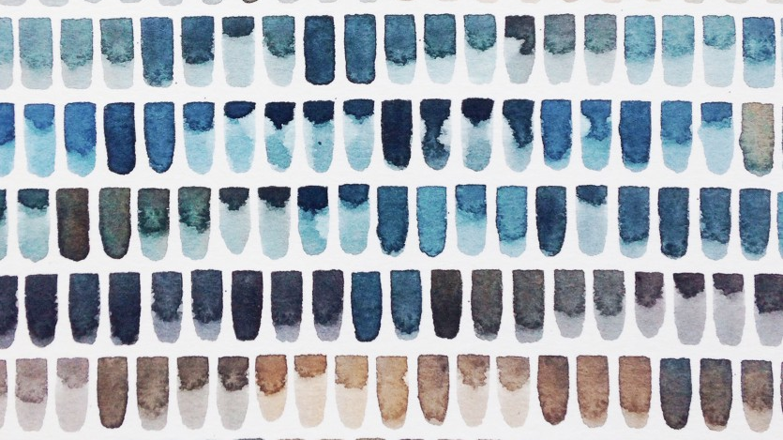
Roanna WELLS
Repetition
https://www.s1artspace.org/studio_artist/roanna-wells/

Slide 2
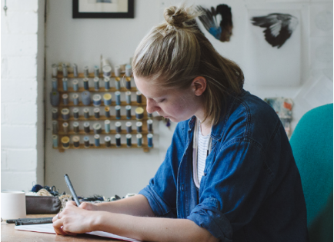
Roanna Wells
Manchester School of Art, Embroidery
“My practice is an intuitive expression of quiet order, subtle structure and collected detail, which is offset by a curiosity into the spontaneous and accidental marks or residues of nature, human interaction and the hand made process.”
https://www.silvineoriginals.co.uk/roanna-wells-fine-artist
https://roannawells.co.uk/about

Slide 3
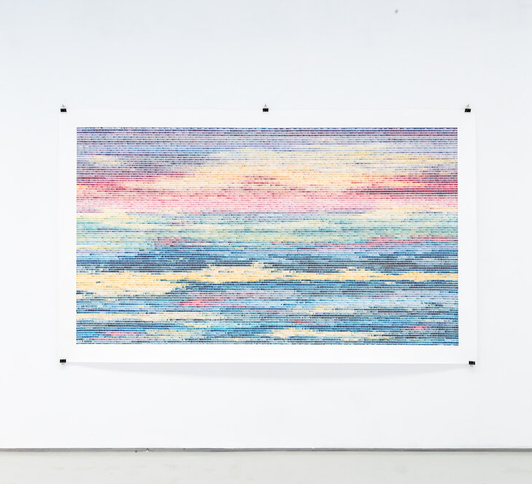
How They Are Ever Changing, 2019
Watercolour on 200gsm cartridge
250 x 150 cm
Client: Mental Health Clinic NY
“I wanted to create something that was both soothing and relaxing, yet intriguing and detailed, to provide opportunity for contemplation or meditation.”
“The title is a description of my mark making given by the client during our planning discussions, which I felt also referenced the changing nature of human thoughts, emotions and states of mind.”
https://www.roannawells.co.uk/projects/howtheyareeverchanging

Slide 4
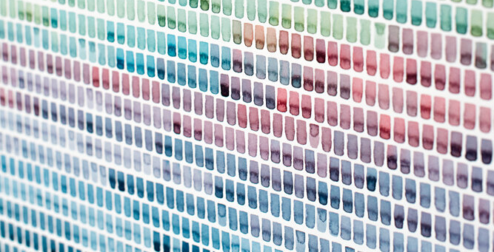

Slide 5
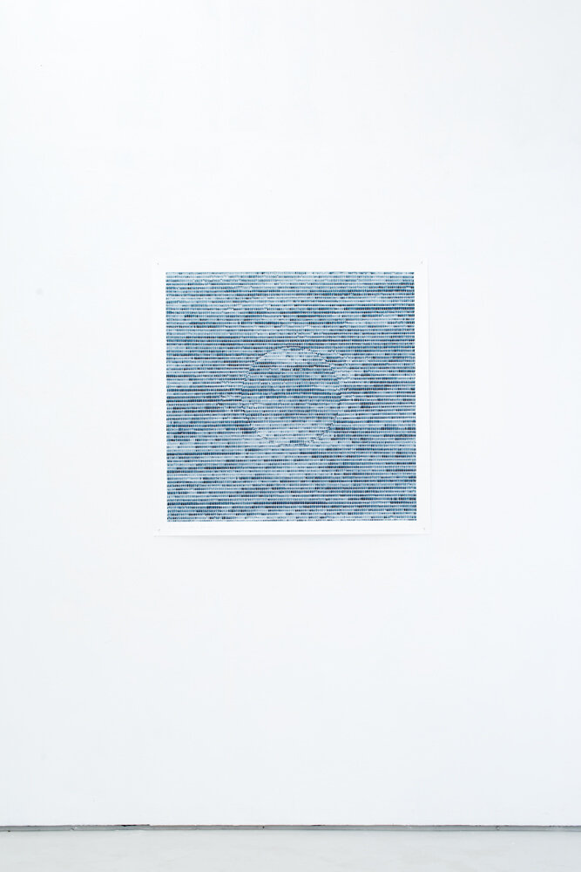
Andacht zum Kleinen (devotion to small things)
2018
Watercolour on 200gsm cartridge each 100 x 100cm
Construction House exhibition at S1 Artspace, Sheffield, coinciding with the 100th anniversary of the Bauhaus.
Each artist was invited to create new work inspired by the teachings, methodologies or aesthetics of the Bauhaus
“This series was inspired by my research of Paul Klee’s Pedagogical Sketchbook” using title statements were lifted directly from Klee’s writing.
'The third dimension, added as optical illusion'
https://www.roannawells.co.uk/projects/andachtzumkleinen

Slide 6
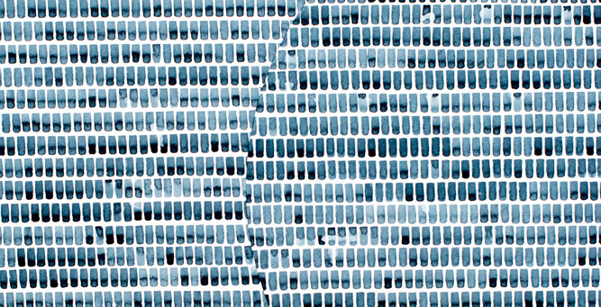

Slide 7
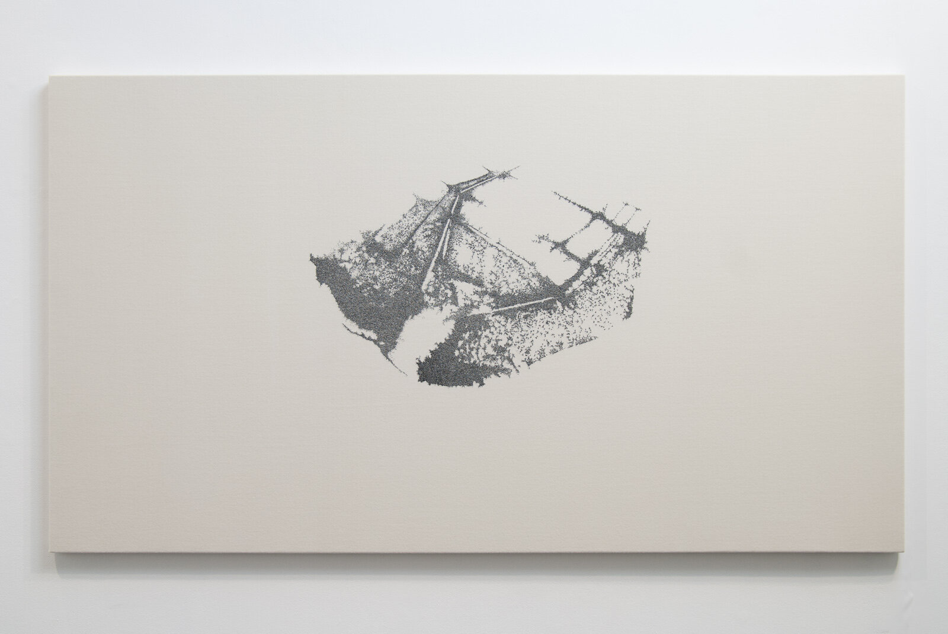
Jerwood Makers Open
2013
‘Sea of Faith’
Hand stitch on wool, 250 x 150cm
‘Interpersonal Spatial Arrangement’ series
“Visiting the Kumbh Mela was such an eye opening, and at times moving, experience for me”
“I wanted to be able to have an even greater depth of meaning to my work, and gain an insight into the nature of this particular crowd. It is the largest gathering of humans on the planet and I was intrigued to see first hand that amount of people in one place and experience the faith and devotion that drives so many to the river Ganges.”
https://www.roannawells.co.uk/projects/jerwood-makers-open
https://jerwoodarts.org/exhibitionsandevents/writing-and-media/makers-open-interviews-roanna-wells/

Slide 8
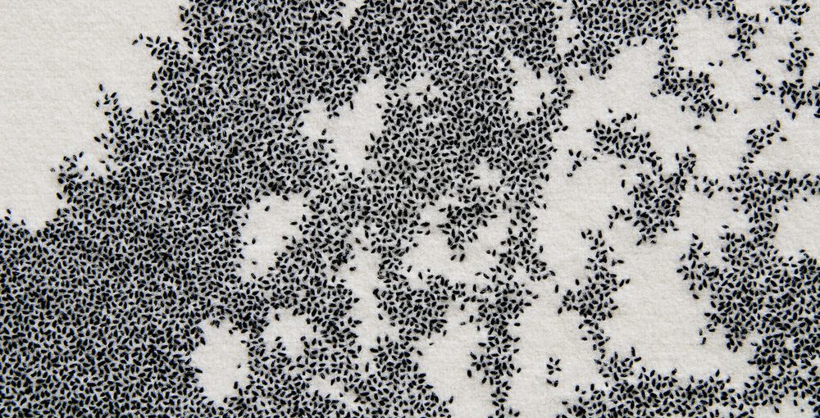

Slide 9
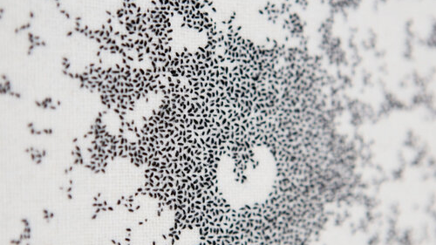
Drowning Victim, Coney Island Beach, New York 1952. 40x40cm (2011)

Slide 10
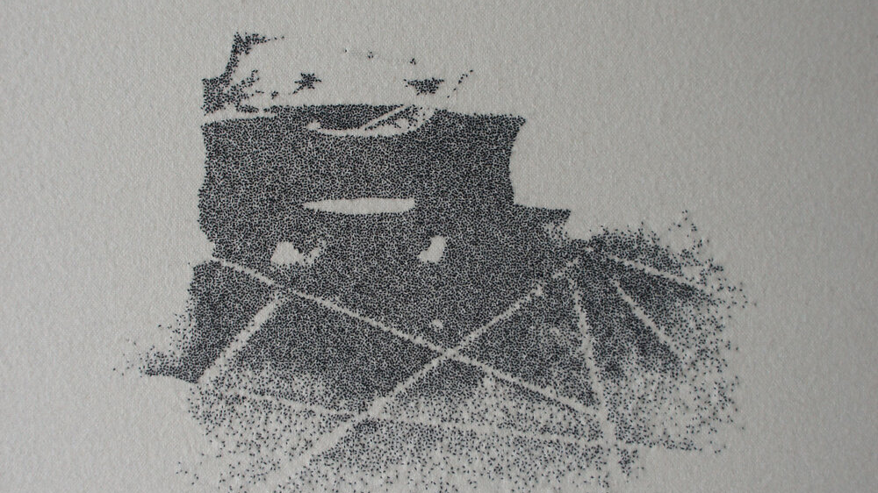
Live 8 concert, Hyde Park, London 2005. 40x40cm (2012)

Slide 11
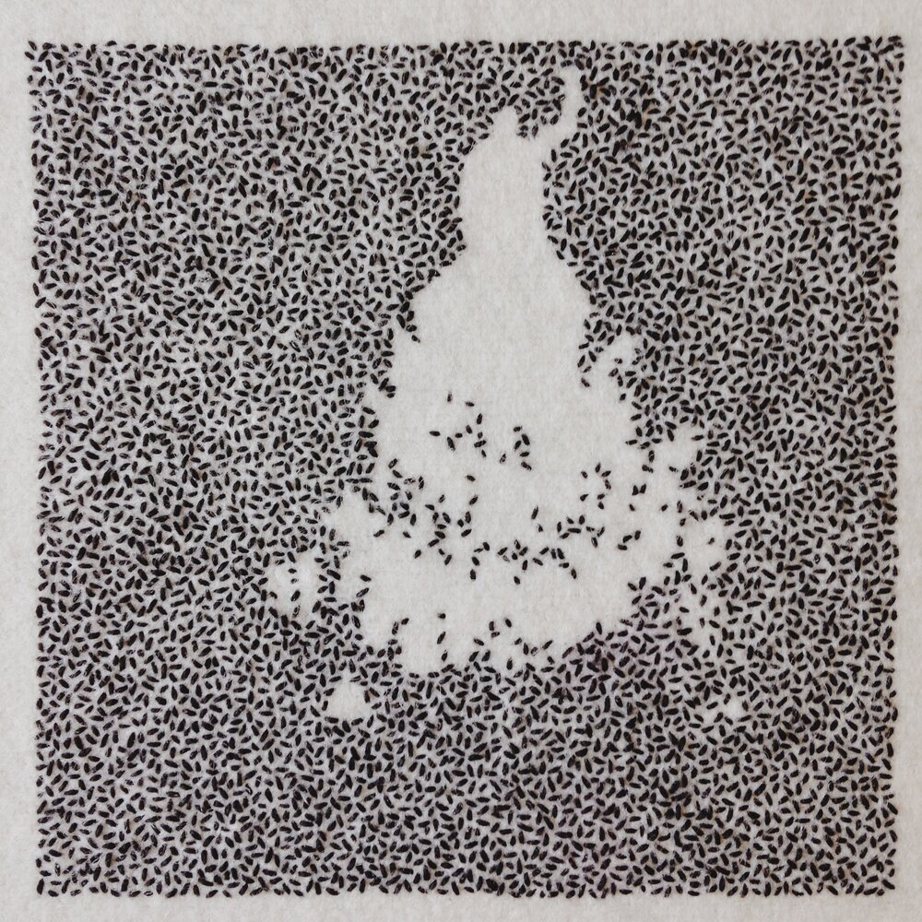
Je Suis Charlie protest, Paris 2015. 11x11cm (2015)

Slide 12
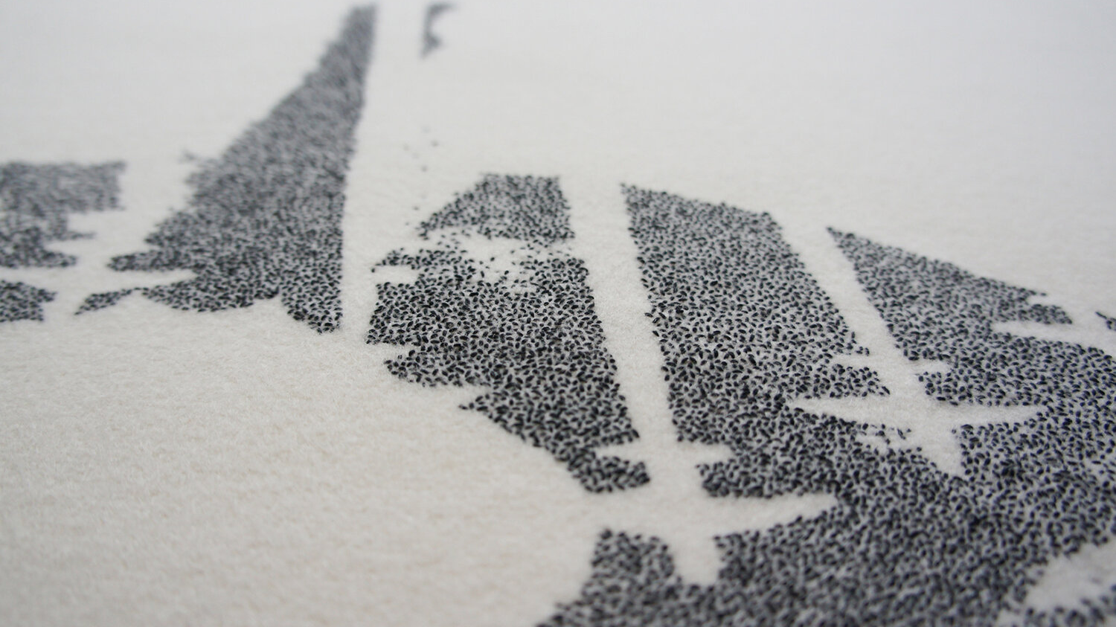
Diamond Jubilee celebrations, Buckingham Palace, London 2012. 140x110cm (2014)

Slide 13
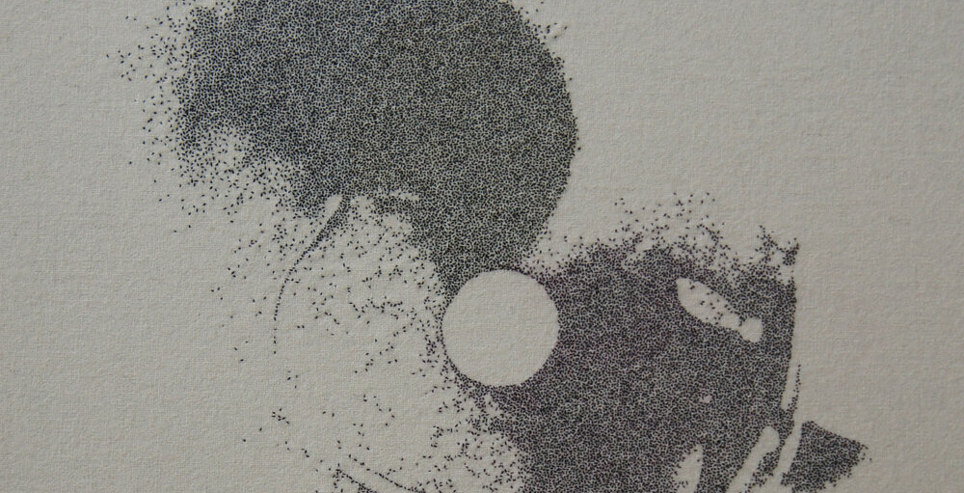
Obama Inauguration ceremony, Washington 2009. Hand stitch on wool 40x40cm (2012)

Slide 14
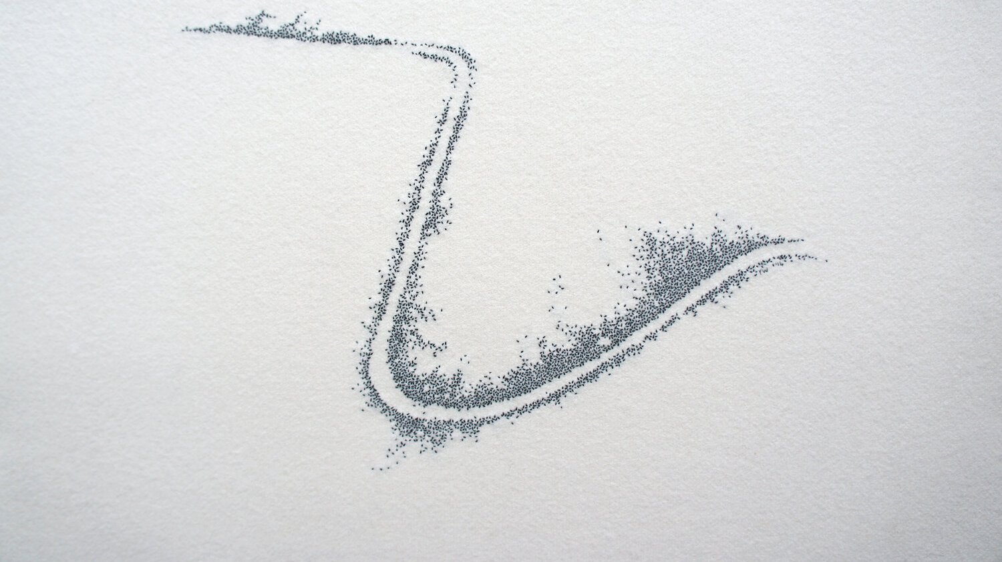
Tour de France, Yorkshire, 2014. 45 x 55 cm (2014)

Slide 15
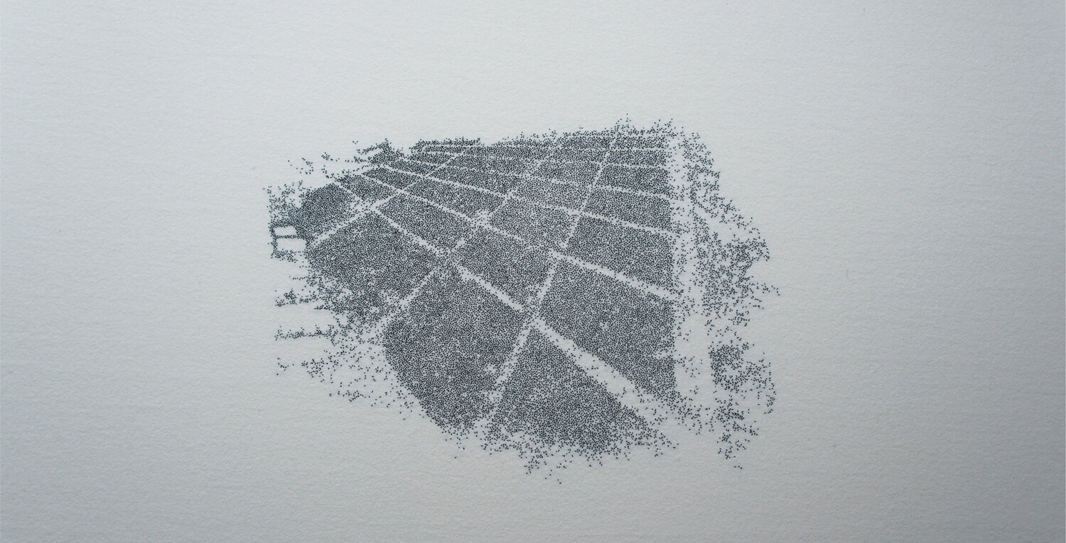
World Youth Day, Madrid 2011. 110x87cm (2014)

Slide 16
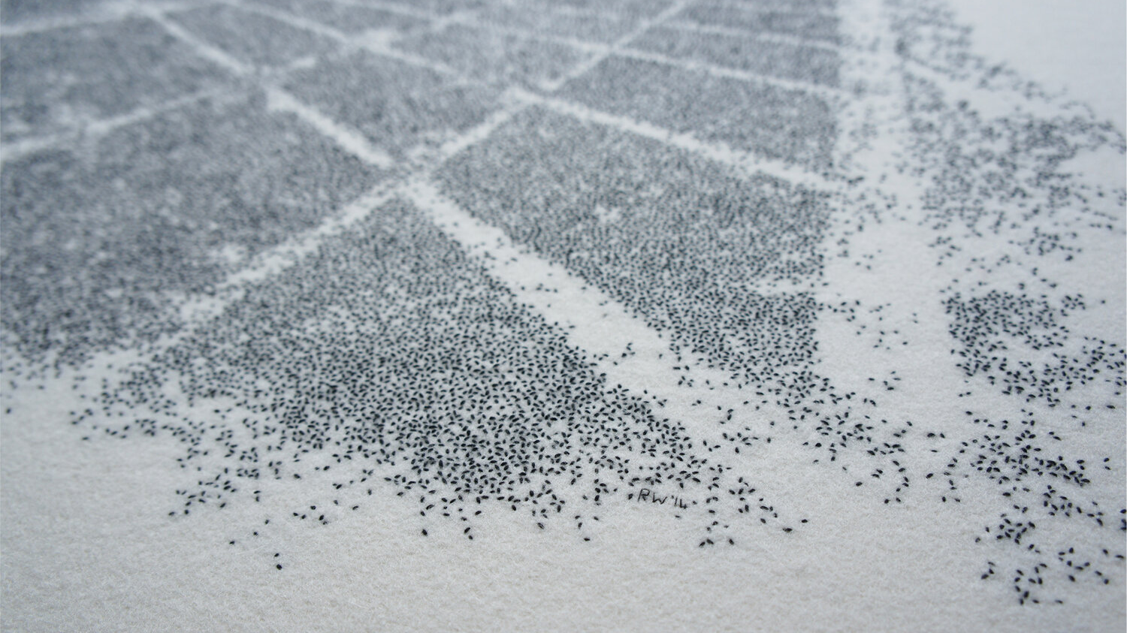

Slide 17
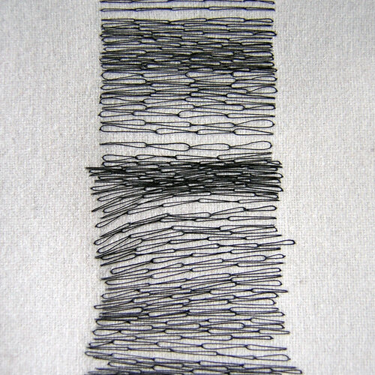
Stitch Archive
2009 - 2015
Hand embroidery on wool and silk crepeline
“I’ve always been fascinated by the similarities and differences between the drawn line on paper and that produced with a needle and thread.”
“I … am interested in the subtle variation between marks even when using a very repetitive technique”
“I love the tactile intensity and time consuming nature of hand embroidery and the ability to create a strong graphic line using soft textured materials.”
https://www.roannawells.co.uk/projects/stitch-archive
Chained

Slide 18
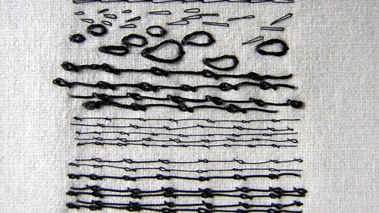
Chained Variation 2

Slide 19
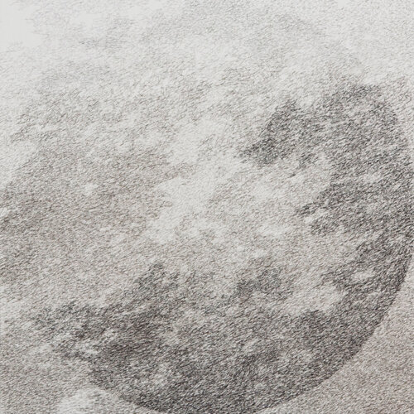
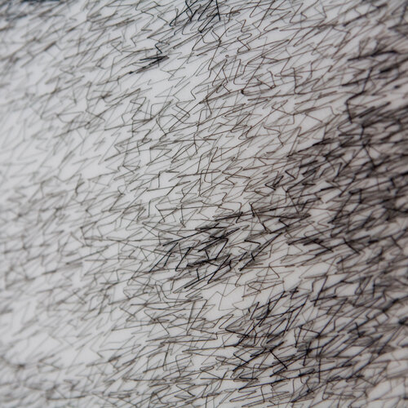
Eclipse
Eclipse - detail

Slide 20
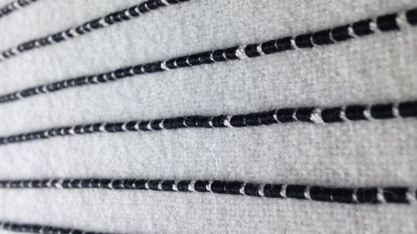

Slide 21
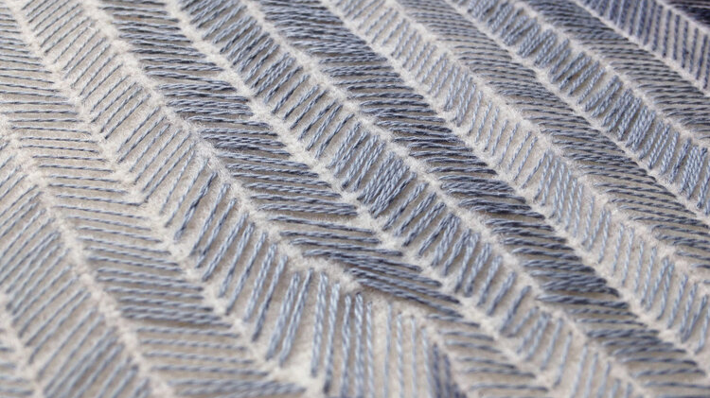
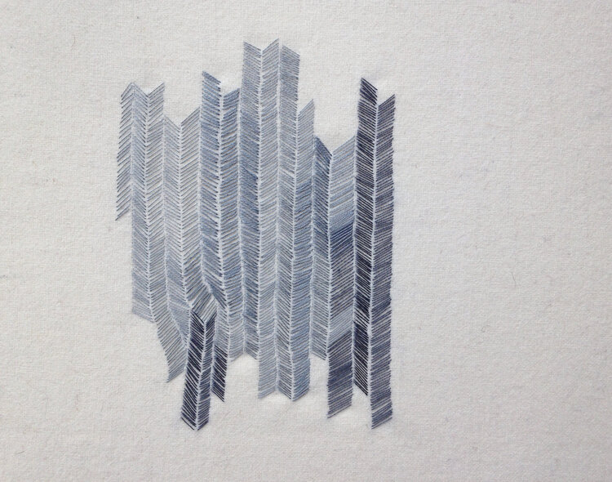
Slow Stitch

Slide 22
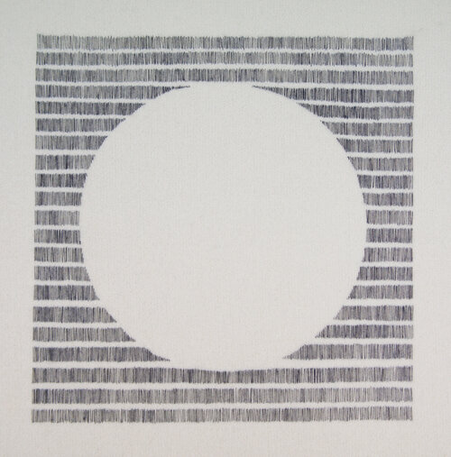
Circle 14

Slide 23
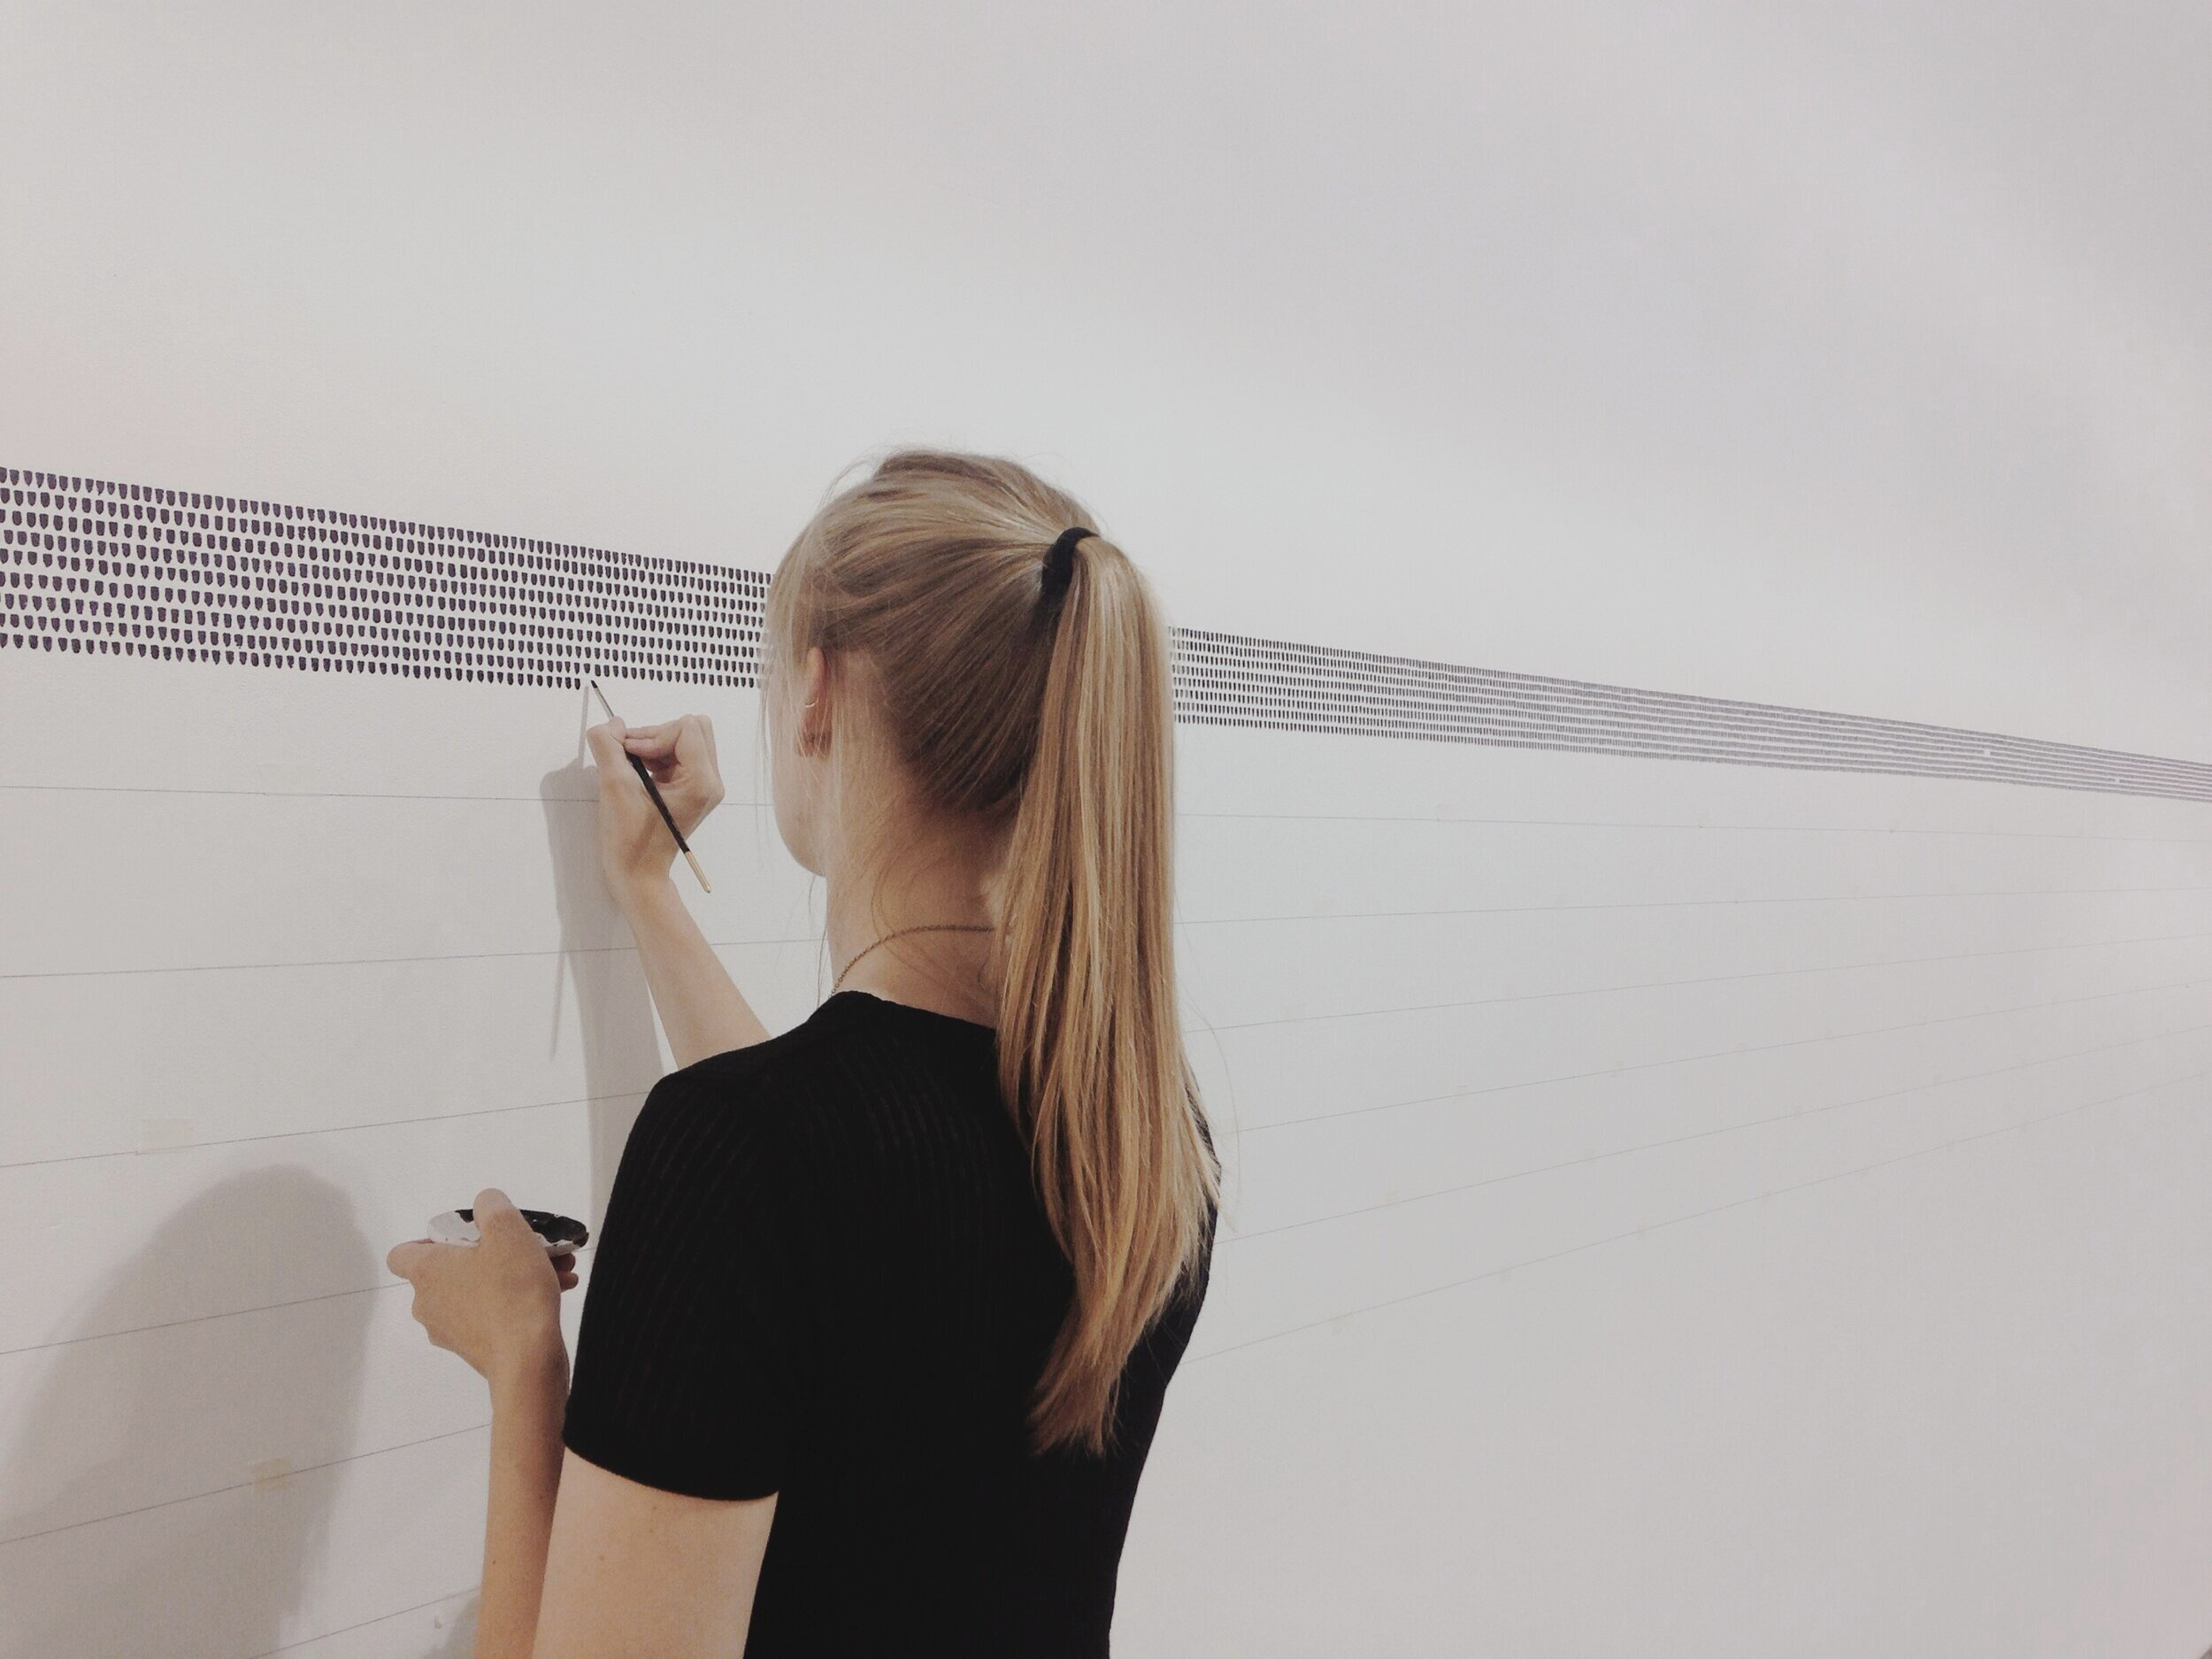
'Desert Island Discs : 45 minutes : 136 episodes'
2014
Watercolour installation direct to the wall
Part of ‘Three Act Structure’ - S1 Artspace Members Show
“It was devised to visually represent the time consuming nature and systematic processes involved in my practice but never normally witnessed by the viewer of the final work.”
”playing each episode out into the space and plotting brushmarks down the length of the gallery wall for the 45 minute duration of each episode.
Punctuation spaces were left between each episode which, as the work progressed, became more prominent in a way that referenced both phrasing in written speech and notes on manuscript”
https://www.roannawells.co.uk/projects/desertislanddiscs
Chained

Slide 24
